Slide 1

Investigating Three Newly Resolved Debris Disks in Scorpius-Centaurus
Kadin Worthen (sophomore)
School of Earth and Space Exploration at Arizona State University.
Advisors: Jennifer Patience and Justin Hom
April 13, 2019
Image Source: JPL

Slide 2
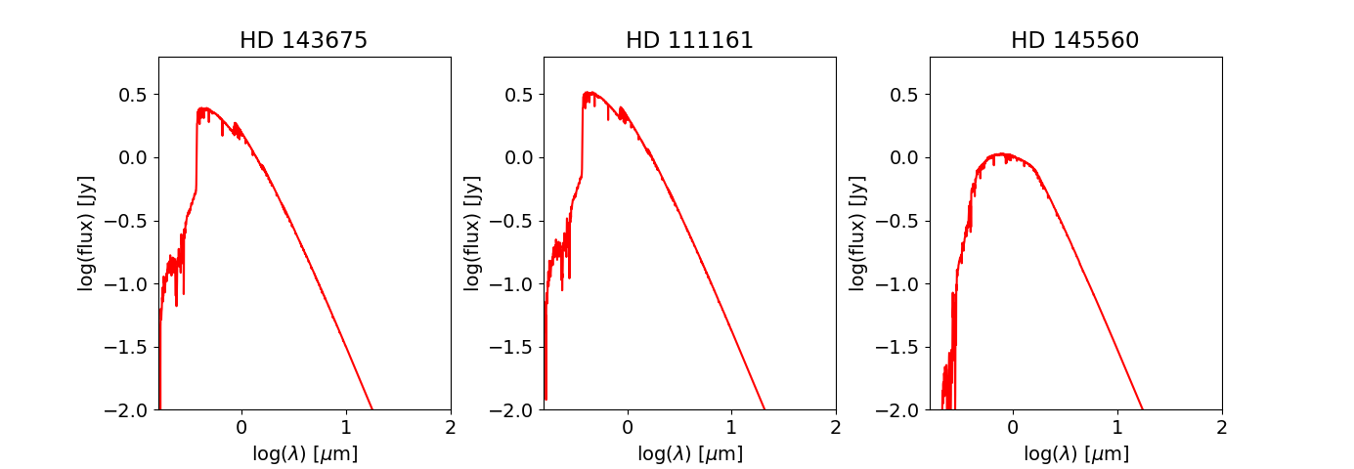
What is a Debris Disk?
Consist of dust particles, grains, and planetesimals in orbit around a star.
Thought to be remnant of planet formation.
Can be found by detecting infrared excess on SED plots
Stellar Spectrum

Slide 3
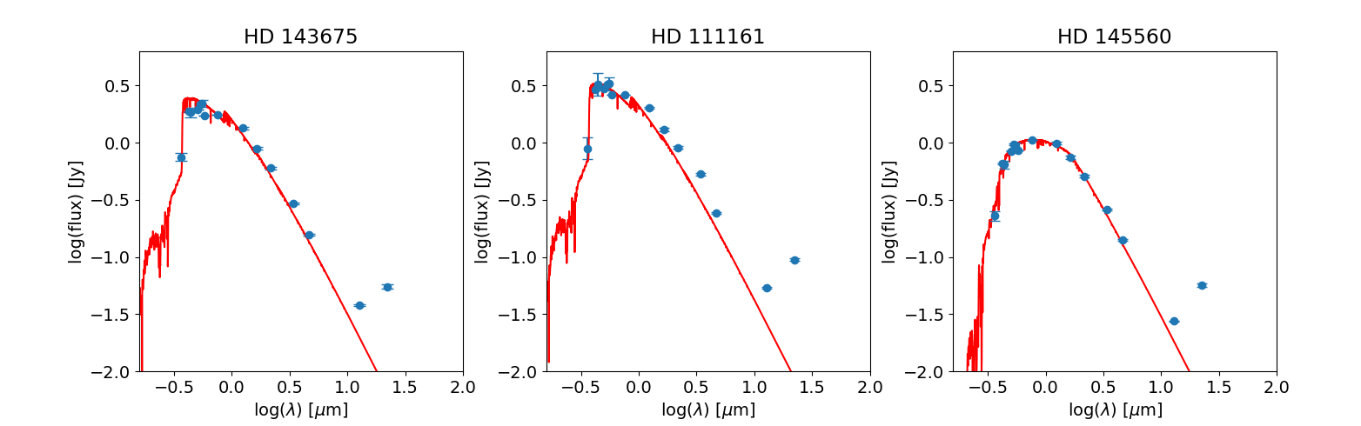
What is a Debris Disk?
Consist of dust particles, grains, and planetesimals in orbit around a star.
Thought to be remnant of planet formation.
Can be found by detecting infrared excess on SED plots

Slide 4
What is a Debris Disk?
Consist of dust particles, grains, and planetesimals in orbit around a star.
Thought to be remnant of planet formation.
Can be found by detecting infrared excess on SED plots
Star Plus Disk

Slide 5
Motivation of Study
SED plots lack details of debris disk structure.
Images of the disks are needed to investigate structure.
Gaps in structure of disk can show presence of planets, as planets can sculpt the shape of disks.
Disks are much fainter than stars they orbit, and are difficult to image because of this.
We can image these disks using the Gemini Planet Imager (GPI) on the Gemini South Telescope, which is one of the largest in the world.
Credit: NOAO

Slide 6

Targets and Observations
Three targets with infrared excess, HD 145560, HD 111161, and HD 143675 were imaged using GPI.
All three disks were detected for the first time in scattered light.
All three stars are between 16-17 Million years old, much younger than the sun, which is 4.6 billion years old.
HD 111161 and HD 143675 are A stars and HD 145560 is an F star. All three stars are hotter than the sun.
Credit: Wikipedia
Targets
Sun

Slide 7
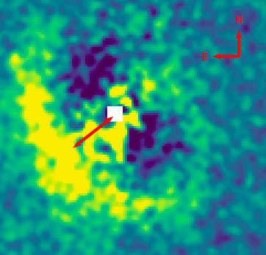
Disk Discovery Image
Image of one of targets taken using GPI to
cancel out starlight.
Scale bar of 40 AU shows orbit of Pluto.
Radius of disk has angular size on the sky
of .7 arcseconds.
Radius of disk is larger than the orbit of
Pluto.
GPI Pixel Scale is .01414 arcseconds/pixel
40 AU
Data of HD 145560

Slide 8
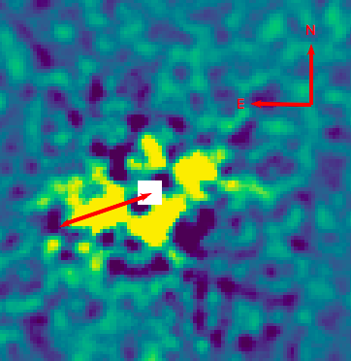
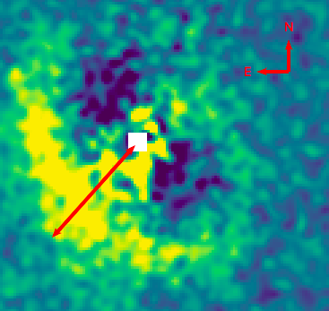
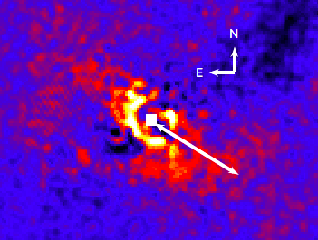
Scattered Light Images of Targets
56 AU
80 AU
68 AU
HD 143675
HD 145560
HD 111161

Slide 9
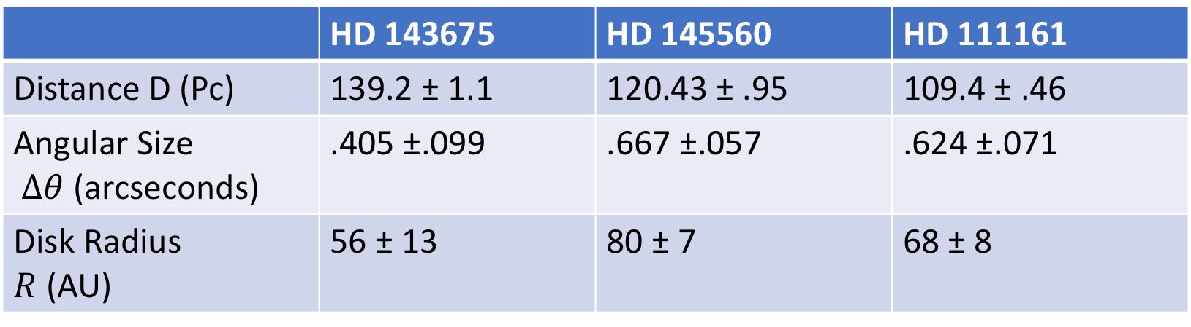

Results
Radii of Disks were estimated using their parallax angle and angular size on the sky with the equations:
D$=\left(\frac{1}{Parallax}\right)$
$R=D(Δθ$)
Parallax From GAIA
Angle Measured from GPI Images
 | HD 143675 | HD 145560 | HD 111161
Distance D (Pc) | 139.2 ± 1.1 | 120.43 ± .95 | 109.4 ± .46
Angular Size $Δθ$ (arcseconds) | .405 ±.099 | .667 ±.057 | .624 ±.071
Disk Radius $R$ (AU) | 56 ± 13 | 80 ± 7 | 68 ± 8

Slide 10
Conclusion and Future Work
We have successfully imaged three newly resolved debris disks around young stars in scattered light.
Sizes of disks range from 40 to 80 AU.
The two young A stars and one young F star were shown to have debris disks with radii larger than the orbit of Pluto.
Future work will involve further analyzing the structure, size, and composition of disks.

